Slide 1
Energy
Chapter 9
page 280 - 307

Slide 2
Page Setup
Set up the first page of every lesson like this and rule a column line for every page after the first page that is used during the lesson.
Focus: State the Chapter Number, Title and the page numbers (3 lines).
Keywords: During the lesson write out your own keywords used during the lesson. (8 lines)
Context: During the lesson write in this section what this topic relates to in the ‘real’ world. How is this content used to better society? (5 lines)

Slide 3
Energy
Chapter 9.1 page 280 - 282

Slide 4
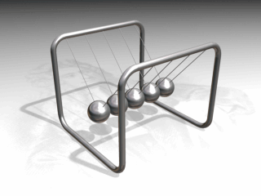
Conservation of Energy
Energy can be neither created nor destroyed.
In an isolated system
it can transform into
other forms of energy.
In general, it can transfer to other systems and/or transform into other forms of energy.

Slide 5

Video

Slide 6
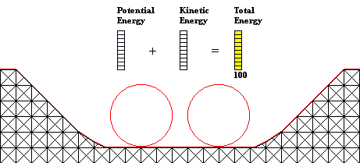
Energy
Energy is measured
  in Joules.
Conservation of energy means energy is energy regardless of the form.
Here we can see the Potential Energy transforms into Kinetic Energy at the beginning of the ride, and converts back to Potential Energy at the end of the ride. The total energy remains unchanged, due to the conservation of energy.

Slide 7

Video

Slide 8
Energy
Example 9.1a: A cyclist in the Tour de France expels on average 41600 kJ of energy a day. If 35% transforms into heat and is transferred to the surrounding air and 5% is converted into the sound energy created by the friction between the wheels and the road, how much energy is used as mechanical energy to move the bike along?

Slide 9
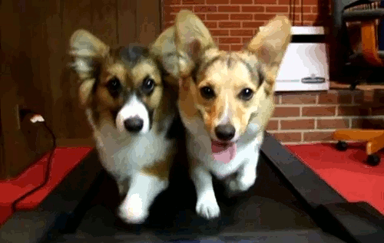
Work
An object is said to have energy if a change occurs.
Definition: What is accomplished on an object by the action of the force.
Work = Force × displacement
W = F s
Units: Joules

Slide 10
Work
Example 9.1b: Calculate the work done by a man who drags a 25 kg bag of salt across the pavers against a frictional force of 55 N for a distance of 12 m.
Example 9.1c: What is the work done by a 45 kg girl when she climbs up an almost vertical ladder 15 m high?.

Slide 11
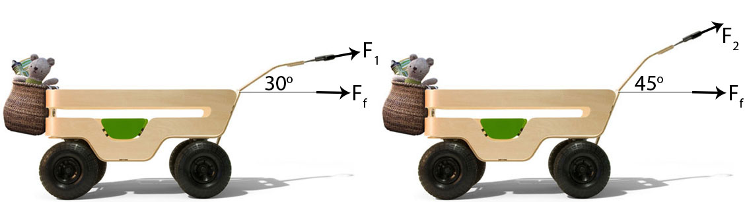
Work
Example 9.1d: A girl pulls a cart by applying a force on the cart handle. The girl can adjust the height of the handle to 45º and 30º. What position will require the least amount of work? (Need to show this using mathematical terms)
Solution
For the purpose of this proof the frictional force, F_{f}, is the same for both carts in the horizontal direction.

Slide 12

Kinetic Energy
Definition: An object in motion has the ability to do work.
Kinetic Energy = ½ × mass × velocity²
E_{k} = ½ × m × v²
E_{k} = ½ × m × (v² – u²)
Units: Joules

Slide 13
Kinetic Energy
Example 9.1e: A car of mass 1120 kg is travelling at 80 km h⁻¹ and slows to 30 km h⁻¹ as it approaches a road works site. The distance travelled during the deceleration is 100 m. Determine;
The cars initial Kinetic Energy
The “Work Done” by the brakes in slowing the car down.
The average force applied by the brakes
The acceleration as the car slows.

Slide 14
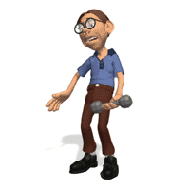
Gravitational Potential Energy
Definition: The stored energy, giving the object the potential to do work.
Gravitational Potential Energy = mass × gravity × height
E_{p} = m × g × h
E_{p} = m × 9.8 × h
Units: Joules

Slide 15
Gravitational Potential Energy
Example 9.1f: Jonny is practising weightlifting by lifting a 160 kg barbell a distance of 1.9 m from the floor. He completes the lift in 1.25 s, holds the barbell for 3 s and then allows it to drop to the floor.
How much work has Jonny done in lifting the barbell?
How much potential energy does the barbell have while being held up for 3 s?
When the barbell is dropped, what is the maximum velocity?

Slide 16
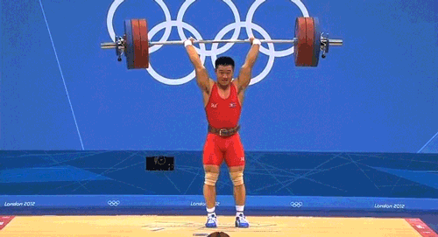
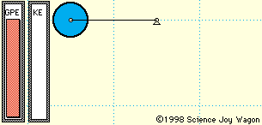
Potential Examples
E_{p(max)} &
E_{k} = 0
E_{k(max)} &
E_{p} = 0

Slide 17
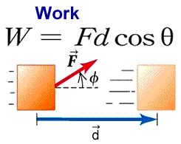
Energy

Slide 18
Homework, Context & Keywords
Context: How is this content used to better society?
The understanding the principles behind energy interaction to better explain the interactions and operations in motion.

Slide 19
Homework, Context & Keywords
Key Words
Energy
Work
Kinetic Energy
Potential Energy
Joules

Slide 20
Homework, Context & Keywords
Homework
Complete all questions from Set 9.1 - due first lesson next week.
Read Chapter 9.2, page 283-289 and answer
Q1, 2 & 3 Set 9.2
by next lesson.

Slide 21
Page Setup
Set up the first page of every lesson like this and rule a column line for every page after the first page that is used during the lesson.
Focus: State the Chapter Number, Title and the page numbers (3 lines).
Keywords: During the lesson write out your own keywords used during the lesson. (8 lines)
Context: During the lesson write in this section what this topic relates to in the ‘real’ world. How is this content used to better society? (5 lines)

Slide 22
Hooke's Law and Work
Chapter 9.2 page 283 - 289

Slide 23
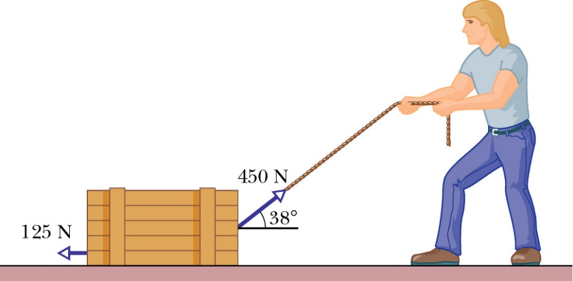
Work applied at angles
Example 9.2a: A man is pulling a box that weighs 50 kg, as shown below. What is the work done if he drags the box 45 m?

Slide 24
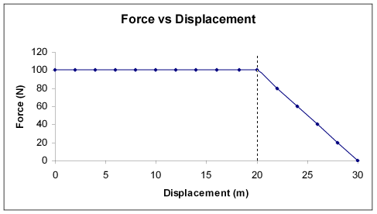
Work and Graphs
Example 9.2b: Casey is pushing a box with a constant force of 100 N for 20 m, before linearly decreasing to force to zero for a further 10 m.
Draw a graph showing this motion.
What is the work done in the first 15 m?
What is the work done in the last 15 m?
A
B

Slide 25
Work and Graphs
Example 9.2c: When Jack was a wee lad, he would often tire quickly. One day he decided to drag a box outside to play. Initially he had plenty of energy and applied a 10 N force for 4 m. Being a wee lad he soon after quickly lost some of his will-power and so declined his efforts linearly to 5 N for the 4 m after that. Amazingly, he held this effort of 5N for a further 4 m. To the point of almost exhaustion Jack slowly lost momentum and came to a stop 2 m after that.
Draw a graph showing this motion.
What is the work done in the first 8 m?
What is the work done during the entire journey?

Slide 26
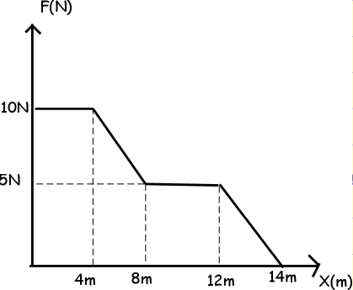
Work and Graphs
Example 9.2c: When Jack was a wee lad, …..
Draw a graph showing
this motion.
What is the work done in the first 8 m?
What is the work done during the entire journey?
A
B
C
D
E

Slide 27
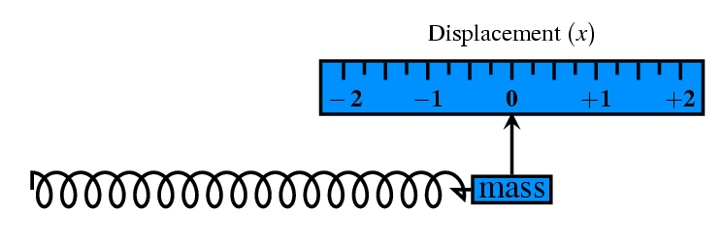
Hooke’s Law
The force acting on an “ideal” spring is proportional to the extension of the spring.
F = k Δx
where F – Force (N)
x – displacement from equilibrium (m)
k – constant based on the stiffness (N m⁻¹)
Stiffness of springs is determined by
The manufacturing process
The composition
The radius of the spring coil and radius of wire ratio

Slide 28
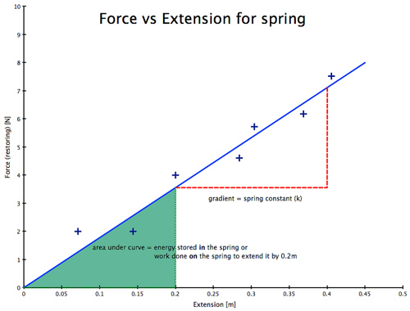
Hooke’s Law
Finding the energy in the spring is E = F × x (area under the line)
Finding the stiffness (k value) is k = F/x (gradient of the line)
Example 9.2d: Find the Energy released from the spring when extended to 0.2 m.
Example 9.2e: Find the stiffness of the spring.

Slide 29
Homework, Context & Keywords
Context: How is this content used to better society?
The understanding the principles behind energy interaction to better explain the interactions and operations in motion.

Slide 30
Homework, Context & Keywords
Key Words
Energy
Work
Force
Hooke’s Law
Stiffness
Joules
Springs

Slide 31
Homework, Context & Keywords
Homework
Complete all questions from Set 9.2 - due first lesson next week.
Read Chapter 9.3, page 289-295 and answer
Q1, 2 & 3 Set 9.3
by next lesson.

Slide 32
Page Setup
Set up the first page of every lesson like this and rule a column line for every page after the first page that is used during the lesson.
Focus: State the Chapter Number, Title and the page numbers (3 lines).
Keywords: During the lesson write out your own keywords used during the lesson. (8 lines)
Context: During the lesson write in this section what this topic relates to in the ‘real’ world. How is this content used to better society? (5 lines)

Slide 33
Work and Power
Chapter 9.3 page 289 - 295

Slide 34

Energy – Where is it?

Slide 35
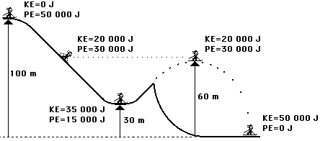
Relationship between E_{k} & E_{p}
At the start we can find the mass of the person: (Find it)
m = 51 kg
At each point the height determines the potential energy.
NOTE: the two points at the same height have the same Potential Energy, and Hence the same Kinetic Energy.
NOTE: the Potential Energy at the start is the same as the Kinetic Energy at the end.

Slide 36
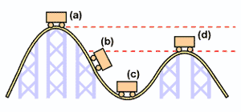
Relationship between E_{k} & E_{p}
Example 9.3a: A roller coaster is constructed so that leading into the first ramp, the truck is pulled up the slope of 42º for a distance of 180 m. The truck and the passengers have a mass of 950 kg and;
Height at (c) = 30 m
Height at (d) = 80 m
What work is done in pulling them up the first slope (a).
Find the velocity of the truck at point (d) if 10% of the potential energy gained at point (a) is lost?
What is the Kinetic Energy at point (b)?
What is the Potential Energy at point (c)?
42º

Slide 37
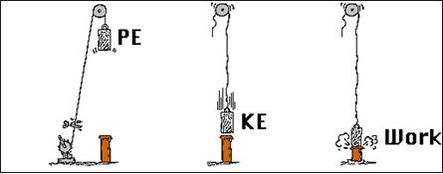

Relationship between E_{k} & E_{p}
At maximum height E_{p} is at maximum. There is no motion, hence E_{k} = 0
ME = E_{k} + E_{p}
= 0 + E_{p}
Since Mechanical Energy is constant for an isolated system
ME₁ = ME₂
0 + E_{p} = E_{k} + 0
E_{k(max)} = E_{p(max)}
½ × m × v² = m × g × h
v = $\sqrt{2 g h }$
At zero height E_{p} = 0. Velocity is at maximum just before impact, hence E_{k} is at maximum.
ME = E_{k} + E_{p}
= E_{k} + 0
Work

Slide 38
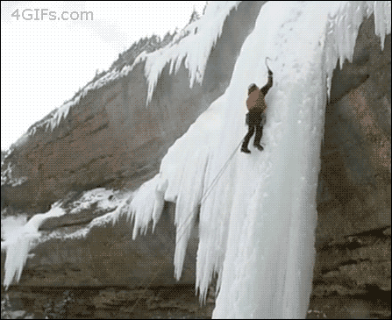
Relationship between E_{k} & E_{p}
Example 9.3b: Climbing ice is a dangerous sport. What is his impact velocity.

Slide 39

Video

Slide 40

Power
P = W = ΔE = F v_{av}
Δt Δt
Units: Watts (W)
Example 9.3c: Robin the weightlifter is a 120 kg muscle man who can easily lift an 80 kg barbell up to his chest from the floor.
What force must Robins arms apply upwards to hold the barbell at his chest, in a stationary position?
When at chest level, the barbell is 146 cm above the floor. What potential energy does the barbell have at this position?
If the lift to his chest took a time of 1.58 s, what power did Robin produce in lifting the weight to his chest?
Whist lifting the 80 kg weight up to his chest, the upwards force in Robin’s arms was 924 N. Calculate the acceleration acting on the weights.

Slide 41
Homework, Context & Keywords
Context: How is this content used to better society?
The understanding the principles behind energy interaction to better explain the interactions and operations in motion.

Slide 42
Homework, Context & Keywords
Key Words
Power
Watts

Slide 43
Homework, Context & Keywords
Homework
Complete all questions from Set 9.3 - due first lesson next week.
Read Chapter 9.4, page 295-307 and answer
Q1, 2 & 3 Set 9.4
by next lesson.

Slide 44
Page Setup
Set up the first page of every lesson like this and rule a column line for every page after the first page that is used during the lesson.
Focus: State the Chapter Number, Title and the page numbers (3 lines).
Keywords: During the lesson write out your own keywords used during the lesson. (8 lines)
Context: During the lesson write in this section what this topic relates to in the ‘real’ world. How is this content used to better society? (5 lines)

Slide 45
Impulse, Inelastic and Elastic Collisions
Chapter 9.4 page 295 - 307

Slide 46
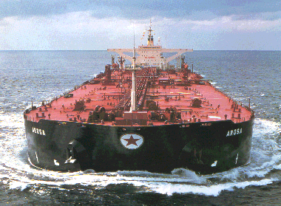
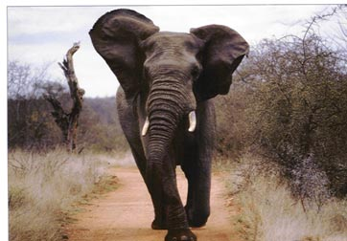
Why can’t it stop easily ??
1. It is MASSIVE
2. It is FAST
IT has a lot of MOMENTUM

Slide 47
Momentum
Definition: Momentum is the tendency of an object to keep moving, based on;
Vector quantity
Mass
Velocity
momentum = mass × velocity
ρ = m v
Units: kg m s⁻¹ or N s

Slide 48
Momentum
An unbalanced force is required to change the momentum of an object.
Also, the change in the momentum of an object is proportional to the net force applied to the object.
Δρ = ρ_{final} – ρ_{initial}
= m v – m u
= F × t

Slide 49
Momentum
Example 9.4a: A car (m = 1200 kg) is travelling at 65 km h⁻¹, when it hits a solid concrete wall, stopping suddenly (t = 0.1 s)
What is the change of momentum during the collision?
What is the average force the car experiences in the collision?

Slide 50
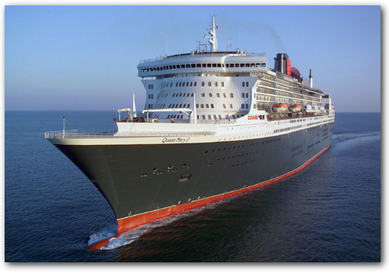
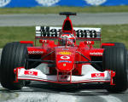
m = 150 000 tonnes
v = 25 knots = 12.5 m s⁻¹
p = ?
150 000 000 kg x 12.5 m s⁻¹
= 1875 000 000 kg m s⁻¹
QM2
= 1.875 x 10⁹ N s
m = 650 kg
v = 200 mph = 89 m s⁻¹
p = ?
Ferrari F1
650 kg x 89 m s⁻¹
= 57 850 kg ms⁻¹
= 5.785 x 10⁴ N s

Slide 51
Impulse
Definition: The affect on the object during a collision.
Example 9.4b: If the car in Example 9.4a is hit hay bails then the impact time would be longer (say t = 10 s). So calculate the force.
As time, t, increases (impact time increases) then the force applied to the object decreases.

Slide 52
Estimation of Time
It is expected that you will be able to estimate collision times with a fair degree of accuracy.
Example 9.4c: Calculate the impulse and force your finger would experience if hit with;
200 g hammer
200 g tube of toothpaste
Both have an impact speed of 20 m s⁻¹.

Slide 53
Conservation of Momentum
Law of Conservation of Momentum states that in any collision or interaction between two or more objects in an isolated system, the total momentum of the system will remain constant. That is, the total initial momentum equals the total final momentum.
Σρ_{i} = Σρ_{f}
m₁u₁ + m₂u₂ = m₁v₁ + m₂v₂
Vector quantity is necessary

Slide 54
Conservation of Momentum
This applies to isolated systems only (i.e. no external forces, like friction, gravity and air resistance), but in reality this type of system is almost impossible to replicate.
Closest real examples of pure conservation of momentum are ice skating or air hockey.

Slide 55
Conservation of Momentum
This principle applies to collisions and to explosions
so
BEFORE
AFTER
u₁
m₂
v₂
m₂
v₁
m₁
u₂
m₁
m₁u₁ + m₂u₂ =
m₁v₁ + m₂v₂
REMEMBER THAT MOMENTUM IS A VECTOR QUANTITY
VECTOR QUANTITY

Slide 56
Conservation of Momentum
Example 9.4d: Initially a car is travelling at 60 km h⁻¹ and weighs 1400 kg when it hits a pedestrian (m = 70 kg) who is initially standing still. What is the velocity after the impact assuming the pedestrian lands on the bonnet and no brakes were applied during the collision.

Slide 57
Conservation of Momentum
Example 9.4e: Initially a red dodgem car is travelling at 4.2 m s⁻¹ and weighs 210 kg when it decides to take on a blue car (m = 240 kg) who is travelling at 5.55 m s⁻¹ in the opposite direction. The impact results in the red car rebounding off the blue car with a speed of 0.56 m s⁻¹. How much did the blue dodgem car slow down by after the collision?

Slide 58
BANG !
Conservation of Momentum
2kg
2kg
4kg
4kg
2 m s⁻¹
2.5ms⁻¹
v = ?
4 m s⁻¹
MOMENTUM BEFORE
=
MOMENTUM AFTER
Example 9.4f: By the Principle of Conservation of Momentum find the final velocity of the 4 kg ball.

Slide 59
Elastic and Inelastic Collisions
In all collisions momentum is conserved
Example: Billiard balls colliding on an ice rink (though it is mostly subatomic particles that closely resemble elastic collisions).
Example: Collision between two balls of play-dough (or any two objects that stick together after impact).
Elastic collisions: Kinetic energy and momentum are conserved.
Σρ_{i} = Σρ_{f}
ΣE_{Ki} = ΣE_{Kf}
Inelastic collisions: Momentum is conserved, however, Kinetic energy is not conserved.
Σρ_{i} = Σρ_{f}
ΣE_{Ki} ≠ ΣE_{Kf}

Slide 60
Elastic Collision
Example 9.4g: An object of mass 2 kg, moving with a velocity of 12 m s⁻¹ collides head on with a stationary object whose mass is 6 kg. Given that the collision is elastic, what is the final velocities of the two objects? Neglect friction.

Slide 61
Inelastic Collision
Example 9.4h: Two asteroids in the Hildas cluster of the asteroid belt are involved in a direct head-on collision. Before the collision, the larger asteroid (mass 3.2 × 10⁴ kg) is travelling at 2.8 × 10² m s⁻¹, and the smaller asteroid (mass 1.8 × 10³ kg) is stationary (relatively speaking). Upon colliding the two asteroids are merged into one.
What is their joint velocity immediately after the collision?
What is the total initial Kinetic energy of the system?
What is the total final Kinetic energy of the system?
What is the difference in Kinetic energy of the system and list two statements that suggest this is an inelastic collision?

Slide 62
Collisions
Example 9.4i: A railway coal truck of mass 4.8 tonnes and moving east at 12 m s⁻¹ collides with a 15.5 tonnes stationary truck on the tracks and locks together with it. At what speed do the two trucks continue moving after the collision? Show whether the collision is elastic or inelastic.

Slide 63
Homework, Context & Keywords
Context: How is this content used to better society?
The understanding the principles behind energy interaction to better explain the interactions and operations in motion.

Slide 64
Homework, Context & Keywords
Key Words
Momentum
Impulse
Conservation of Momentum
Elastic Collisions
Inelastic Collisions

Slide 65
Homework, Context & Keywords
Homework
Complete all questions from Set 9.4 - due first lesson next week.
Complete Chapter 9 Review, page 308-309 - due first lesson next week.
Read Chapter 10.1, page 312-318 and answer
Q1 Set 10.1
by first lesson next term.

